Slide 1

PREDICTING WEATHER WITH BAYES' THEOREM
PRESENTED BY:
A INDU SREE-22H51A0402
B CHARITH- 22H51A0404
B NIKHIL – 22H51A0405

Slide 2

PREDICTING WEATHER WITH BAYES' THEOREM
Weather forecasting has evolved significantly with the incorporation of probabilistic methods.
One powerful tool for improving prediction accuracy is Bayes' Theorem, which combines prior knowledge and observed data to refine estimates.
This presentation explores how Bayes' Theorem can be applied to forecasting weather conditions such as rain, snow, or sunshine, helping meteorologists make better-informed decisions.

Slide 3

INTRODUCTION TO BAYES' THEOREM
Conditional Probability
Bayes’ Theorem Formula
Represents the probability of an event A happening given that another event B has occurred, noted as P(A|B).
P(A|B) = [P(B|A) × P(A)] / P(B)
Probability Components
P(A|B): Posterior probability
P(B|A): Likelihood of evidence given event
P(A): Prior probability
P(B): Evidence or total probability of B

Slide 4

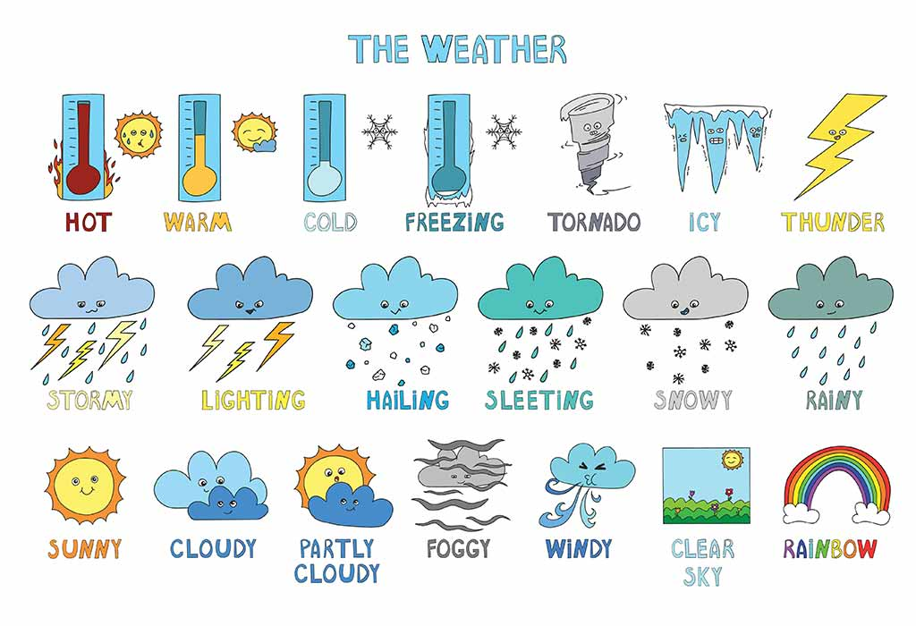
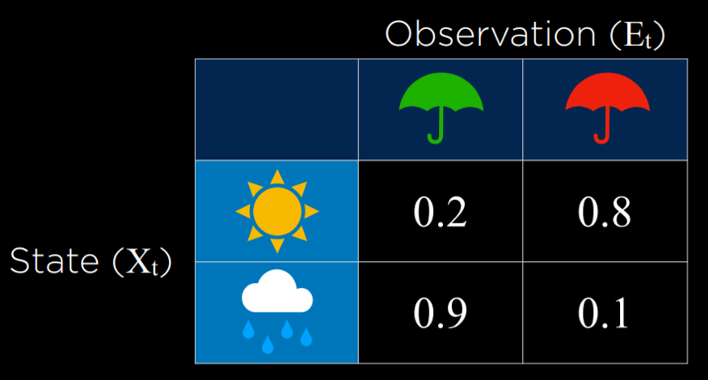
WEATHER PREDICTION: DEFINING EVENTS
Event A
Event B
Goal
This refers to the specific weather condition we aim to predict, such as rain, snow, or sunshine on a given day.
These are measurable atmospheric variables, like humidity, temperature, and air pressure, crucial in influencing weather outcomes.
To determine the probability of rain given observed high humidity: P(Rain | High Humidity), enhancing the forecast reliability using Bayes' Theorem.

Slide 5

PRIOR PROBABILITY: HISTORICAL WEATHER DATA
Baseline Probability
Significance
Derived from long-term observation; for example, if historically it rains 30 days each year out of 365, the prior probability P(Rain) equals approximately 0.082.
These prior probabilities form the foundational baseline for Bayesian weather forecasts, grounding predictions in known climatic trends.
Data Sources
Modern meteorology uses decades of accumulated weather records to establish these priors accurately for various locations and seasons.

Slide 6

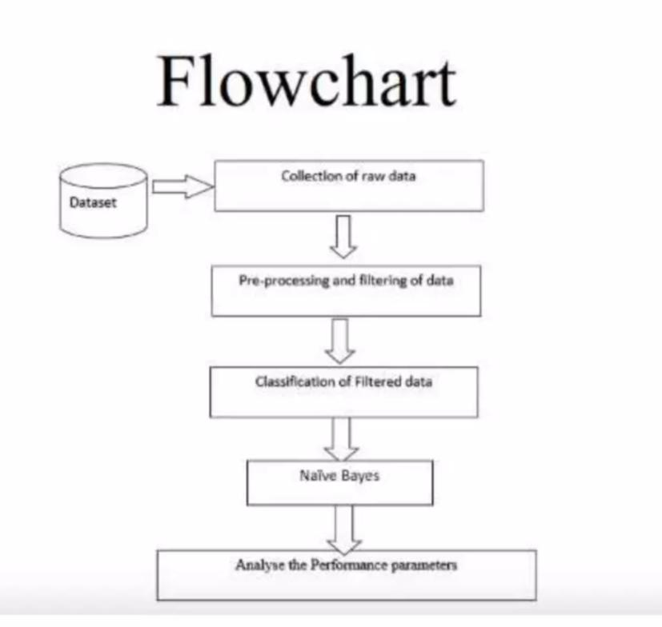
IMPLEMENTATION
Data Preparation: The process begins with the collection of raw data from the dataset, followed by pre-processing and filtering to clean and organize the data.
Classification Step: After preparing the data, it is classified using the Naïve Bayes algorithm, which is a probabilistic classifier.
Performance Evaluation: Finally, the performance of the classification model is analyzed by assessing relevant performance parameters.

Slide 7
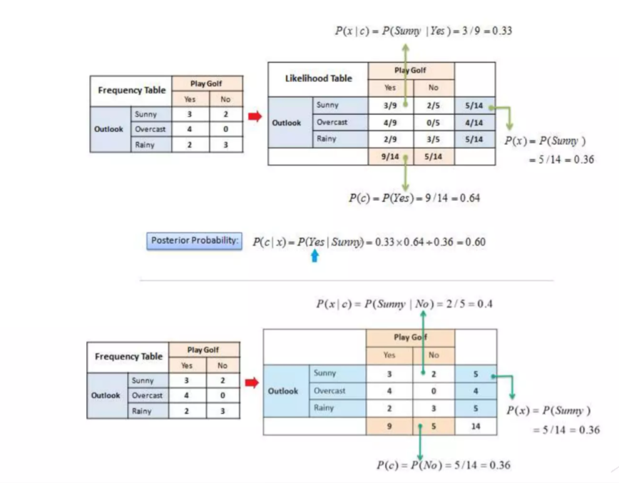
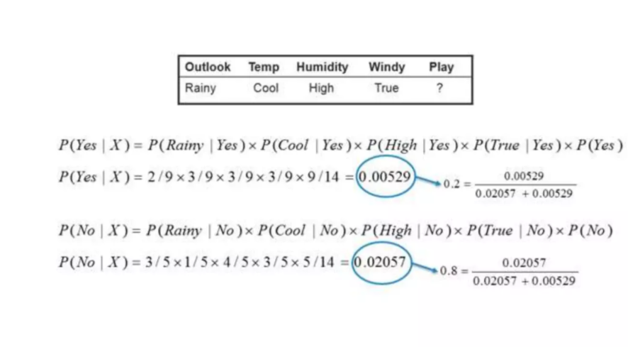

Slide 8
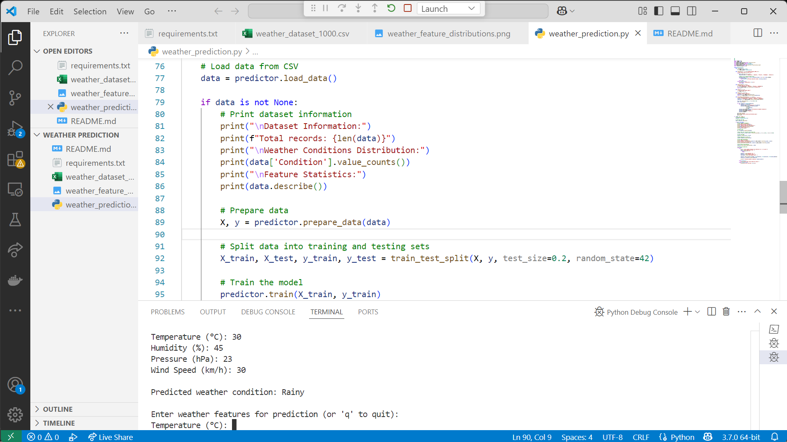
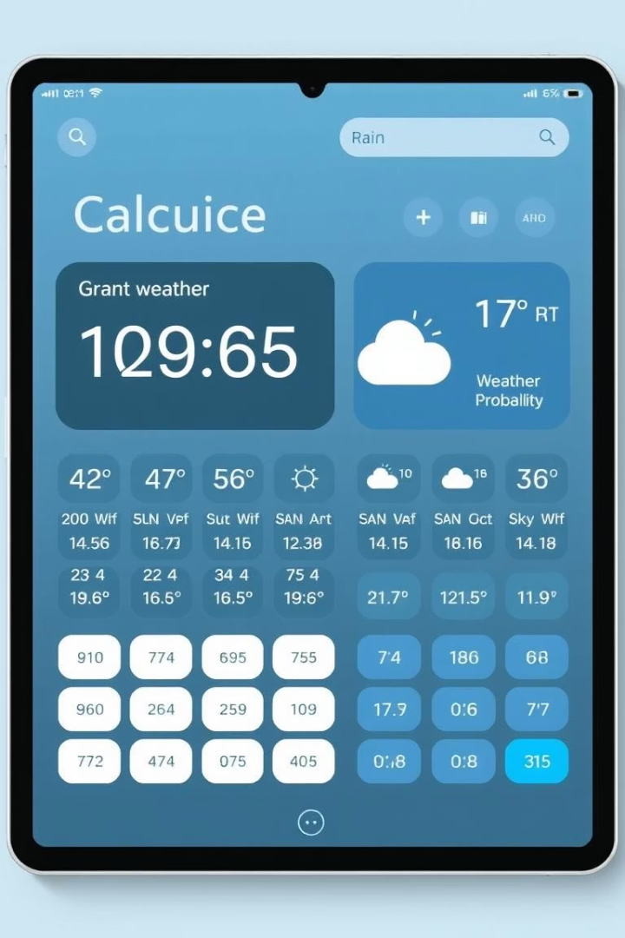

Slide 9
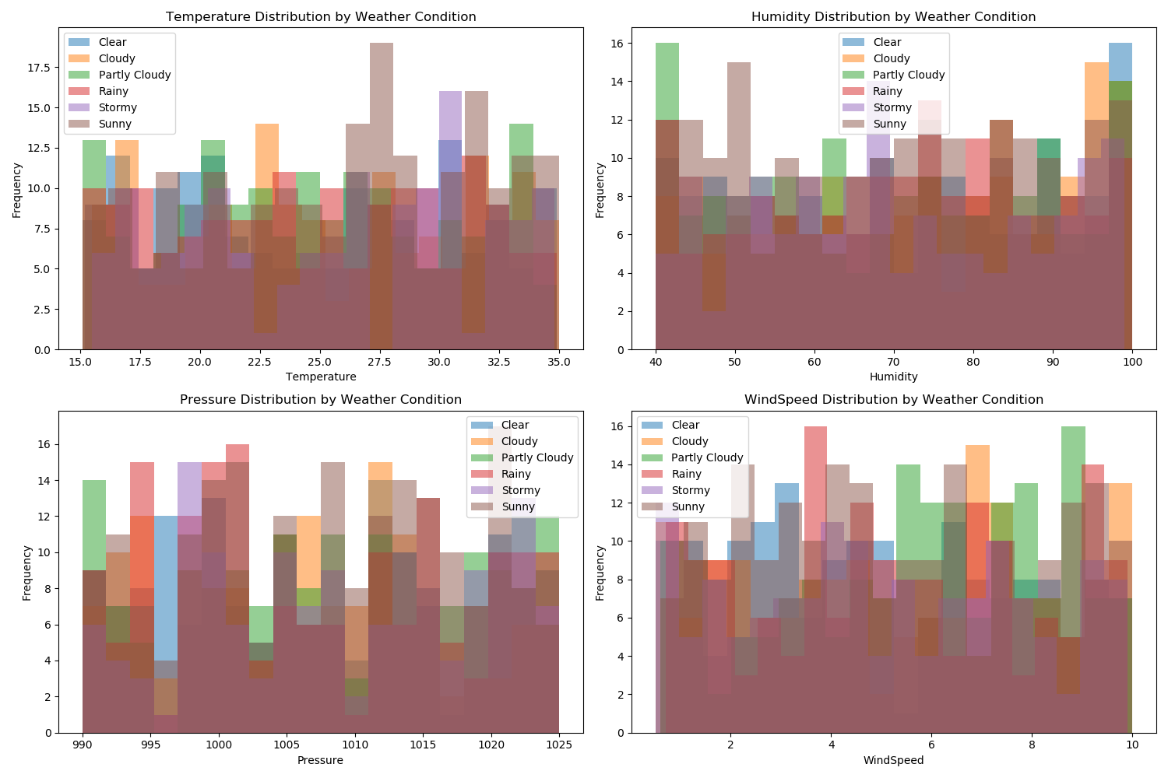

Slide 10


Advantages and Limitations
Limitations
Advantages
Relies on accurate and representative prior probabilities
Integrates prior knowledge with new evidence
Sensitive to poor quality or incomplete data inputs
Continuously updates predictions as new data arrives
Model assumptions can oversimplify complex weather systems
Provides probabilistic instead of deterministic forecasts
1
2

Slide 11

CONCLUSION
Summary
Future Outlook
Bayes' Theorem offers a sophisticated statistical framework that enhances weather prediction by combining long-term data with real-time measurements.
Integrating more diverse data sources like satellite imagery and IoT sensors promises finer, localized forecasts.
Such advancements will improve early warnings and decision-making for weather-dependent activities.
This method provides probabilistic insights that complement traditional forecasting techniques.

Slide 12
THANK YOU

